Slide 1

Data Structures
Week 4 - Sorting Algorithms
Juan Carlos Pineda
ITESM
juancarlos.pineda@itesm.mx

Slide 2
Sorting
Sorting is nothing but arranging the data in ascending or descending order. The term sorting came into picture, as humans realised the importance of searching quickly
Sorting is important because, as seen in the previous lesson searching for values is critical in any activity

Slide 3
Sorting Efficiency
How would you sort a deck of cards?
What is the best (more efficient) way to do it?
What can be the difference in the input?

Slide 4
Sorting Efficiency
The two main criterias to judge which algorithm is better than the other have been:
Time taken to sort the given data.
Memory Space required to do so.

Slide 5
Sorting Algorithms
Bubble Sort
Insertion Sort
Merge Sort
Selection Sort
Quick Sort
Heap Sort

Slide 6
Bubble Sort
Bubble Sort is a simple algorithm which is used to sort a given set of n elements provided in form of an array with n number of elements. Bubble Sort compares all the element one by one and sort them based on their values.

Slide 7
Bubble Sort
If the given array has to be sorted in ascending order, then bubble sort will start by comparing the first element of the array with the second element, if the first element is greater than the second element, it will swap both the elements, and then move on to compare the second and the third element, and so on.
If we have total n elements, then we need to repeat this process for n-1 times.
Notes:
It is known as bubble sort, because with every complete iteration the largest element in the given array, bubbles up towards the last place or the highest index, just like a water bubble rises up to the water surface.
Sorting takes place by stepping through all the elements one-by-one and comparing it with the adjacent element and swapping them if required.

Slide 8
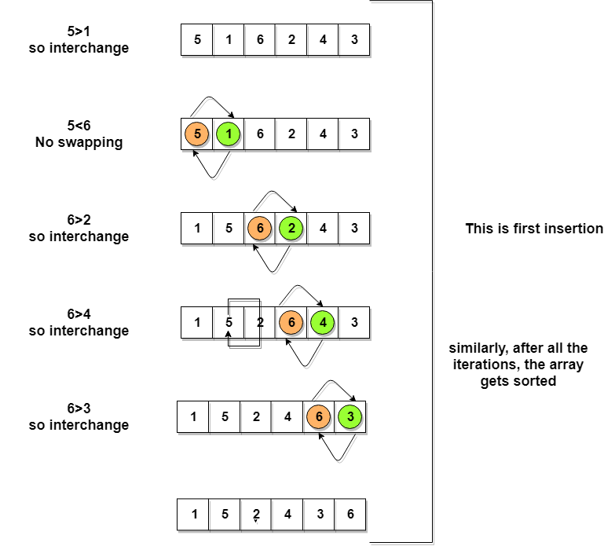
Implementing Bubble Sort
Notes:
Following are the steps involved in bubble sort(for sorting a given array in ascending order):
Starting with the first element(index = 0), compare the current element with the next element of the array.
If the current element is greater than the next element of the array, swap them.
If the current element is less than the next element, move to the next element. Repeat Step 1.
Let's consider an array with values {5, 1, 6, 2, 4, 3}

Slide 9
Implementing Bubble Sort
< Code Time>
Notes:
Go to document with code

Slide 10
Implementing Bubble Sort
What is the current complexity of the Bubble Sort?
After looking at the Implementation, what improvements can be made?
Notes:
Show code first

Slide 11
Implementing Bubble Sort
To optimize our bubble sort algorithm, we can introduce a flag to monitor whether elements are getting swapped inside the inner for loop.
Hence, in the inner for loop, we check whether swapping of elements is taking place or not, everytime.
Let's consider an array with values {11, 17, 18, 26, 23}

Slide 12
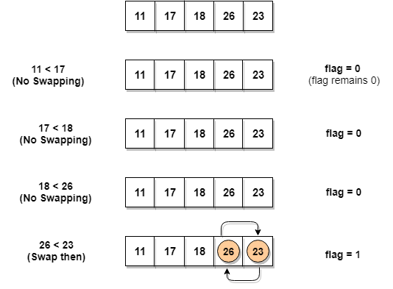
Implementing Bubble Sort

Slide 13
Optimized Bubble Sort
As seen in the implementation, a small change in the code might bring big benefits
Even with the change, Bubble Sort is still not the best algorithm to sort.
Let’s look into more efficient algorithms

Slide 14
Let’s breathe….
Questions?

Slide 15
Complexity Analysis of Bubble Sort
How many comparisons do we have in Bubble Sort?
First we have n - 1
Then n - 2
..
.
3
2
1

Slide 16
Complexity Analysis of Bubble Sort
Then we have (n-1) + (n-2) + (n-3) … + 3 + 2+ 1
That is: (n-1)/2
Hence the complexity of Bubble Sort is O(n²)

Slide 17
Advantages of Bubble Sort
The main advantage of Bubble Sort is the simplicity
The space complexity is 1, as only one additional memory space is required
The best case time complexity is O (n)

Slide 18
Recap…

Slide 19
Insertion Sort
Consider you have 10 cards out of a deck of cards in your hand. And they are sorted, or arranged in the ascending order of their numbers.
If I give you another card, and ask you to insert the card in just the right position, so that the cards in your hand are still sorted. What will you do?
Notes:
You will have to go through each card from the starting or the back and find the right position for the new card, comparing it's value with each card. Once you find the right position, you will insert the card there.
Similarly, if more new cards are provided to you, you can easily repeat the same process and insert the new cards and keep the cards sorted too.

Slide 20
Insertion Sort Characteristics
It is efficient for smaller data sets, but very inefficient for larger lists.
Insertion Sort is adaptive, that means it reduces its total number of steps if a partially sorted array is provided as input, making it efficient.
It is better than Selection Sort and Bubble Sort algorithms.
Its space complexity is less. Like bubble Sort, insertion sort also requires a single additional memory space.
It is a stable sorting technique, as it does not change the relative order of elements which are equal.

Slide 21
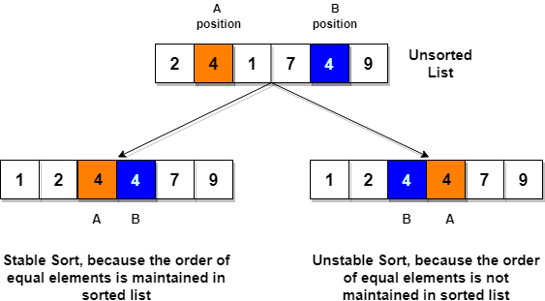
Stable Sorting

Slide 22
Insertion Sort Steps
We start by making the second element of the given array, i.e. element at index 1, the key. The key element here is the new card that we need to add to our existing sorted set of cards(remember the example with cards above).
We compare the key element with the element(s) before it, in this case, element at index 0:
If the key element is less than the first element, we insert the key element before the first element.
If the key element is greater than the first element, then we insert it after the first element.
Then, we make the third element of the array as key and will compare it with elements to it's left and insert it at the right position.
And we go on repeating this, until the array is sorted.

Slide 23
Insertion Sort Complexity
Worst Case Time Complexity [ Big-O ]: O(n2)
Best Case Time Complexity [Big-omega]: O(n)
Average Time Complexity [Big-theta]: O(n2)
Space Complexity: O(1)

